Slide 1
On-Policy Deep Reinforcement Learning for the Average-Reward Criterion
E1-227 Reinforcement Learning
PROJECT PRESENTATION
Zhang, Y. and Ross, K.W., 2021, July. On-policy deep reinforcement learning for the average-reward criterion. In International Conference on Machine Learning (pp. 12535-12545). PMLR.
Abhijeet A T (21067)
Abhishek Dhar (21368)
Aravind S (21690)

Slide 2
OUTLINE
Introduction
Preliminaries
Main Results
Practical Algorithm
Results and Our Work

Slide 3
INTRODUCTION
Most DRL literature focuses on discounted rewards.
This paper derives a novel bound that depends on the average divergence between two policies and Kemeny’s constant.
Based on the bound, the authors propose an iterative procedure that produces a sequence of monotonically improved policies for the average reward criterion.

Slide 4
PRELIMINARIES

Slide 5
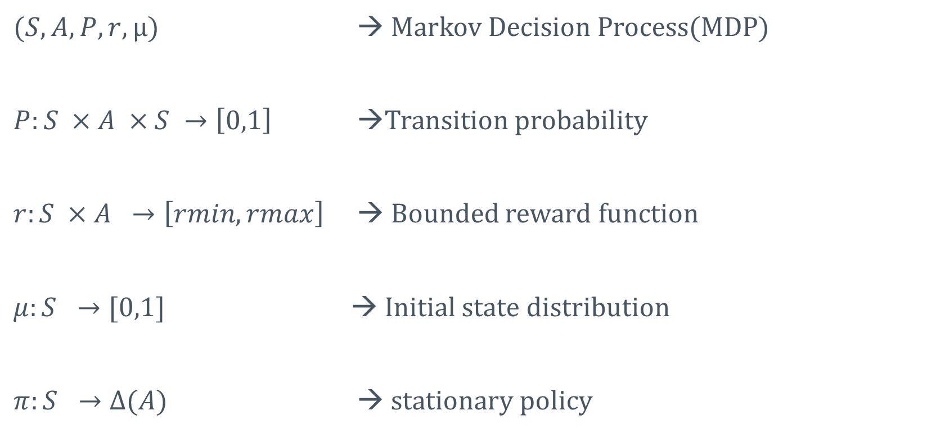
NOTATIONS
$(S,A,P,r,μ)$ → Markov Decision Process(MDP)
$P:S ×A ×S →\left[0,1\right]$ →Transition probability
$r:S ×A →\left[rmin,rmax\right]$ → Bounded reward function
$μ:S →[0,1]$ → Initial state distribution
$π:S →Δ(A)$ → stationary policy

Slide 6
ASSUMPTIONS
Assumption 1 - (Ergodic):
For every stationary policy, the induced Markov chain is irreducible and aperiodic.
Assumption 2 - (Aperiodic Unichain):
For every stationary policy, the induced Markov chain contains a single aperiodic recurrent class and a finite but possibly empty set of transient states.

Slide 7
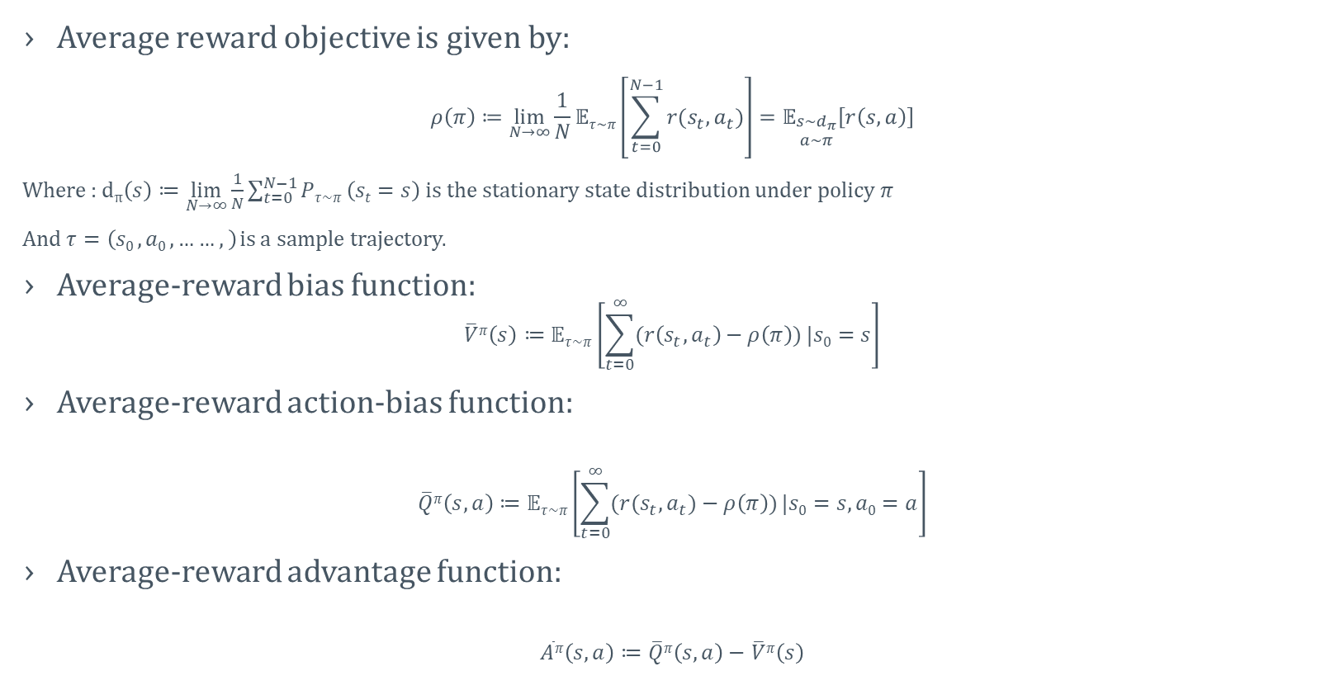
AVERAGE REWARD CRITERION
Average reward objective is given by:
$$ρ\left(π\right)≔\lim_{N→∞}{\frac{1}{N}𝔼τ\sim π\left[\sum_{t=0}^{N−1}{r(s_{t},a_{t})}\right]}=𝔼_{\begin{matrix}s\sim d_{π} \\ a\sim π\end{matrix}}\left[r\left(s,a\right)\right]$$
Where : d$π\left(s\right)≔\lim_{N→∞}{\frac{1}{N}\sum_{t=0}^{N−1}{Pτ\sim π}\left(st=s\right)}$ is the stationary state distribution under policy $π$
And $τ=\left(s0 ,a0 ,……,\right)$ is a sample trajectory.
Average-reward bias function:
$$\overline{V}π\left(s\right)≔𝔼τ\sim π\left[\sum_{t=0}^{∞}{(r\left(s_{t},a_{t}\right)−ρ\left(π\right))}|s0=s\right]$$
Average-reward action-bias function:
$$\overline{Q}π\left(s,a\right)≔𝔼τ\sim π\left[\sum_{t=0}^{∞}{(r(s_{t},a_{t})−ρ\left(π\right))}|s0=s,a0=a\right]$$
Average-reward advantage function:
$$\overline{A}π\left(s,a\right)≔\overline{Q}π\left(s,a\right)−\overline{V}π\left(s\right)$$

Slide 8
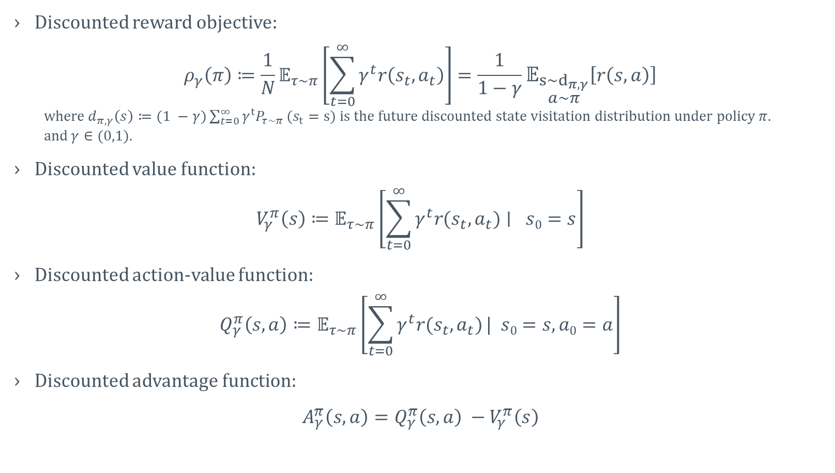
DISCOUNTED REWARD CRITERION
Discounted reward objective:
$$ρ_{γ}\left(π\right)≔\frac{1}{N}𝔼_{τ\sim π}\left[\sum_{t=0}^{∞}{γ^{t}r\left(s_{t}, a_{t}\right)}\right]=\frac{1}{1−γ}𝔼_{\begin{matrix}s\sim d_{π,γ} \\ a\sim π\end{matrix}}\left[r\left(s,a\right)\right]$$
where $d_{π,γ}\left(s\right)≔(1 −γ)\sum_{t=0}^{∞}{γ^{t}P_{τ\sim π}}(s_{t}=s)$is the future discounted state visitation distribution under policy $π.$
and$γ∈(0,1)$.
Discounted value function:
$$V_{γ}^{π}\left(s\right)≔𝔼_{τ\sim π}\left[\sum_{t=0}^{∞}{γ^{t}r(s_{t}, a_{t})}∣ s0=s\right]$$
Discounted action-value function:
$$Q_{γ}^{π}\left(s,a\right)≔𝔼_{τ\sim π}\left[\sum_{t=0}^{∞}{γ^{t}r(s_{t}, a_{t})}| s0=s,a0=a\right]$$
Discounted advantage function:
$A_{γ}^{π}\left(s,a\right)=Q_{γ}^{π}\left(s,a\right) −$ $V_{γ}^{π}\left(s\right)$

Slide 9
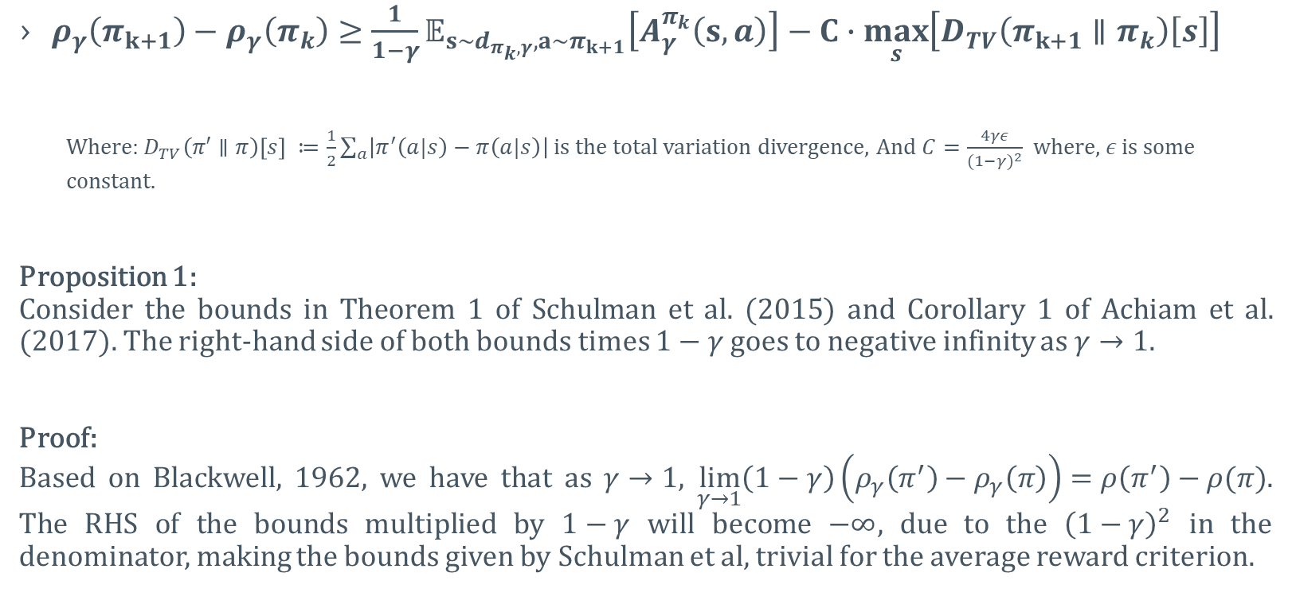
MONOTONICALLY IMPROVEMENT GUARANTEES FOR DISCOUNTED RL
$ρ_{γ}\left(π_{k+1}\right)−ρ_{γ}\left(π_{k}\right)≥\frac{1}{1−γ}𝔼_{s\sim d_{π_{k},γ},a\sim π_{k+1}}\left[A_{γ}^{π_{k}}\left(s,a\right)\right]−C∙\max_{s}\left[D_{TV}\left(π_{k+1}∥π_{k}\right)\left[s\right]\right]$
Where: $D_{TV}\left(π′∥π\right)\left[s\right] ≔\frac{1}{2}\sum_{a}{\left|π^{′}\left(a|s\right)−π\left(a|s\right)\right|}$ is the total variation divergence, And $C=\frac{4γε}{{(1−γ)}^{2}}$ where, $ε$ is some constant.
Proposition 1:
Consider the bounds in Theorem 1 of Schulman et al. (2015) and Corollary 1 of Achiam et al. (2017). The right-hand side of both bounds times $1−γ$ goes to negative infinity as $γ→1$.
Proof:
Based on Blackwell, 1962, we have that as $γ→1$, $\lim_{γ→1}\left(1−γ\right)\left(ρ_{γ}\left(π^{′}\right)−ρ_{γ}\left(π\right)\right)=ρ\left(π^{′}\right)−ρ(π)$. The RHS of the bounds multiplied by $1−γ$ will become $−∞$, due to the ${\left(1−γ\right)}^{2}$ in the denominator, making the bounds given by Schulman et al, trivial for the average reward criterion.

Slide 10
MAIN RESULTS

Slide 11
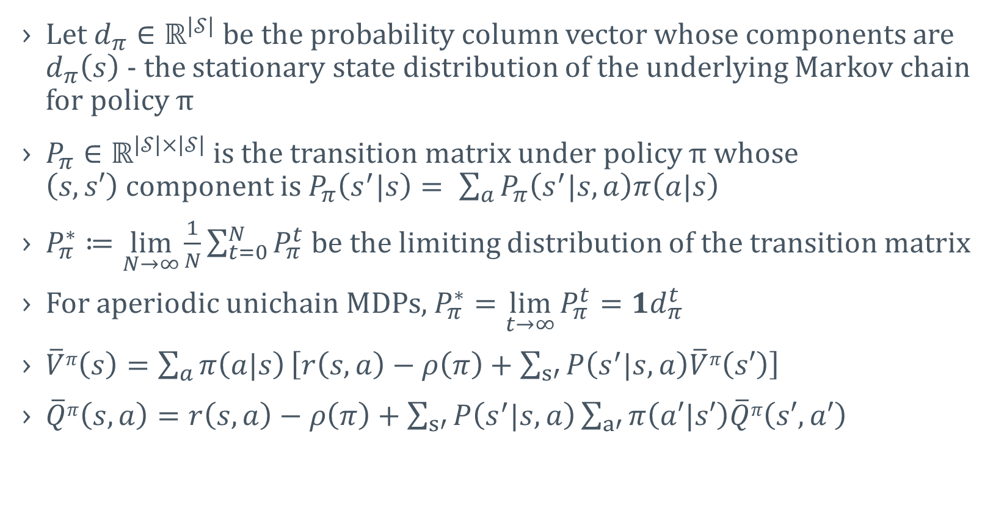
NOTATIONS
Let $d_{π}∈ℝ^{\left|𝒮\right|}$ be the probability column vector whose components are $d_{π}\left(s\right)$ - the stationary state distribution of the underlying Markov chain for policy π
$P_{π}∈ℝ^{\left|𝒮\right|×\left|𝒮\right|}$ is the transition matrix under policy π whose $\left(s,s′\right)$component is $P_{π}\left(s^{′}|s\right)= \sum_{a}{P_{π}\left(s^{′}|s,a\right)π\left(a|s\right)}$
$P_{π}^{∗}≔\lim_{N→∞}{\frac{1}{N}\sum_{t=0}^{N}{P_{π}^{t}}}$be the limiting distribution of the transition matrix
For aperiodic unichain MDPs, $P_{π}^{∗}=\lim_{t→∞}{P_{π}^{t}}=1d_{π}^{t}$
$\overline{V}π\left(s\right)=\sum_{a}{π\left(a|s\right)}\left[r\left(s, a\right)−ρ\left(π\right)+\sum_{s′}{P\left(s^{′}|s,a\right)\overline{V}π\left(s′\right)}\right]$
$\overline{Q}π\left(s,a\right)=r\left(s, a\right)−ρ\left(π\right)+\sum_{s′}{P\left(s^{′}|s,a\right)}\sum_{a′}{π\left(a′|s′\right)\overline{Q}π\left(s′,a′\right) }$

Slide 12
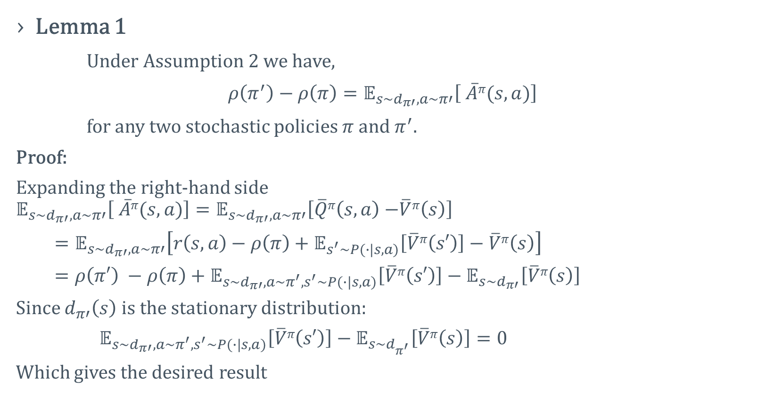
AVERAGE REWARD POLICY IMRPOVEMENT THEOREM
Lemma 1
Under Assumption 2 we have,
$ρ\left(π^{′}\right)−ρ\left(π\right)=𝔼_{s\sim d_{π′},a\sim π′}\left[ \overline{A}π(s,a)\right]$
for any two stochastic policies $π$and $π^{′}.$
Proof:
Expanding the right-hand side
$$𝔼_{s\sim d_{π′},a\sim π′}\left[ \overline{A}π(s,a)\right]=𝔼_{s\sim d_{π′},a\sim π′}\left[\overline{Q}π\left(s,a\right)−\overline{V}π\left(s\right)\right]$$
$=𝔼_{s\sim d_{π′},a\sim π′}\left[r\left(s, a\right)−ρ\left(π\right)+𝔼_{s^{′}\sim P(∙|s,a)}\left[\overline{V}π\left(s′\right)\right]−\overline{V}π\left(s\right)\right]$
$=ρ\left(π′\right) −ρ\left(π\right)+𝔼_{s\sim d_{π′},a\sim π^{′},s^{′}\sim P(∙|s,a)}\left[\overline{V}π\left(s′\right)\right]−𝔼_{s\sim d_{π′}}\left[\overline{V}π\left(s\right)\right]$
Since $d_{π′}\left(s\right)$ is the stationary distribution:
$𝔼_{s\sim d_{π′},a\sim π^{′},s^{′}\sim P(∙|s,a)}\left[\overline{V}π\left(s′\right)\right]−𝔼_{s\sim d_{π^{′}}}\left[\overline{V}π\left(s\right)\right]=0$
Which gives the desired result

Slide 13
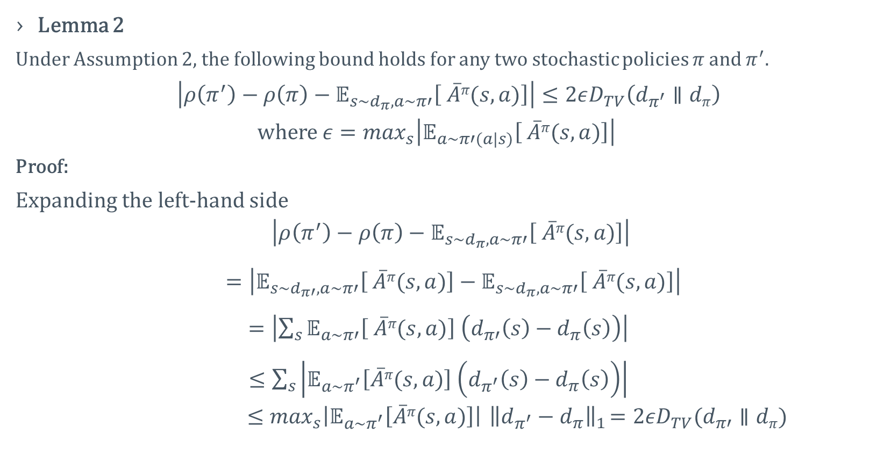
AVERAGE REWARD POLICY IMRPOVEMENT THEOREM
Lemma 2
Under Assumption 2, the following bound holds for any two stochastic policies $π$and $π^{′}.$
$\left|ρ\left(π^{′}\right)−ρ\left(π\right)−𝔼_{s\sim d_{π},a\sim π′}\left[ \overline{A}π(s,a)\right]\right|≤2εD_{TV}\left(d_{π^{′}}∥dπ\right)$
where $ε=\max_{s}\left|𝔼_{a\sim π′(a|s)}\left[ \overline{A}π(s,a)\right]\right|$
Proof:
Expanding the left-hand side
$$\left|ρ\left(π^{′}\right)−ρ\left(π\right)−𝔼_{s\sim d_{π},a\sim π′}\left[ \overline{A}π(s,a)\right]\right|$$
$=\left|𝔼_{s\sim d_{π′},a\sim π′}\left[ \overline{A}π(s,a)\right]−𝔼_{s\sim d_{π},a\sim π′}\left[ \overline{A}π(s,a)\right]\right|$
$=\left|\sum_{s}{𝔼_{a\sim π′}\left[ \overline{A}π(s,a)\right] \left(d_{π′}\left(s\right)−d_{π}\left(s\right)\right)}\right|$
$≤\sum_{s}{\left|𝔼_{a\sim π^{′}}\left[\overline{A}π(s,a)\right] \left(d_{π^{′}}\left(s\right)−d_{π}\left(s\right)\right)\right|}$
$$≤\max_{s}\left|𝔼_{a\sim π^{′}}\left[\overline{A}π(s,a)\right]\right|{ \left\|d_{π^{′}}−d_{π}\right\|}_{1}=2εD_{TV}(d_{π′}∥dπ)$$

Slide 14
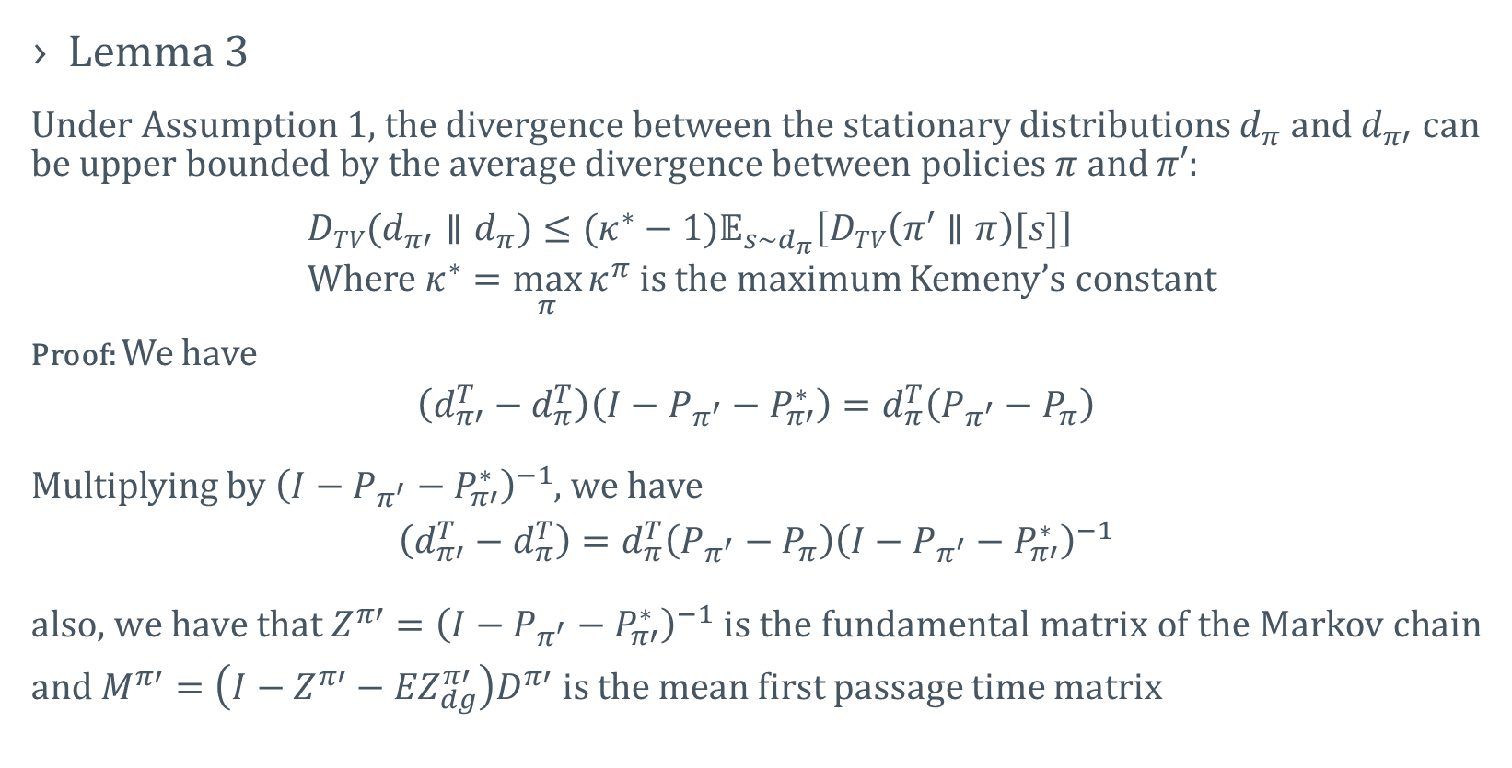
AVERAGE REWARD POLICY IMRPOVEMENT THEOREM
Lemma 3
Under Assumption 1, the divergence between the stationary distributions $d_{π}$ and $d_{π′}$ can be upper bounded by the average divergence between policies $π$ and $π′$:
$DTV(d_{π′}∥d_{π})≤(κ^{∗}−1)𝔼_{s\sim d_{π}}\left[DTV\left(π′∥π\right)[s]\right]$
Where $κ^{∗}=\max_{π}{κ^{π}}$ is the maximum Kemeny’s constant
Proof: We have
$$\left(d_{π′}^{T}−d_{π}^{T}\right)\left(I−P_{π^{′}}−P_{π′}^{∗}\right)=d_{π}^{T}\left(P_{π^{′}}−P_{π}\right)$$
Multiplying by ${\left(I−P_{π^{′}}−P_{π′}^{∗}\right)}^{−1}$, we have
$$\left(d_{π′}^{T}−d_{π}^{T}\right)=d_{π}^{T}\left(P_{π^{′}}−P_{π}\right){\left(I−P_{π^{′}}−P_{π′}^{∗}\right)}^{−1}$$ $\text{also}\text{, }\text{we} \text{have} \text{that} {Z^{π′}=\left(I−P_{π^{′}}−P_{π′}^{∗}\right)}^{−1} is$ the fundamental matrix of the Markov chain $\text{and} M^{π′}=\left(I−Z^{π′}−{EZ}_{dg}^{π′}\right)D^{π′} is the$ mean first passage time matrix

Slide 15
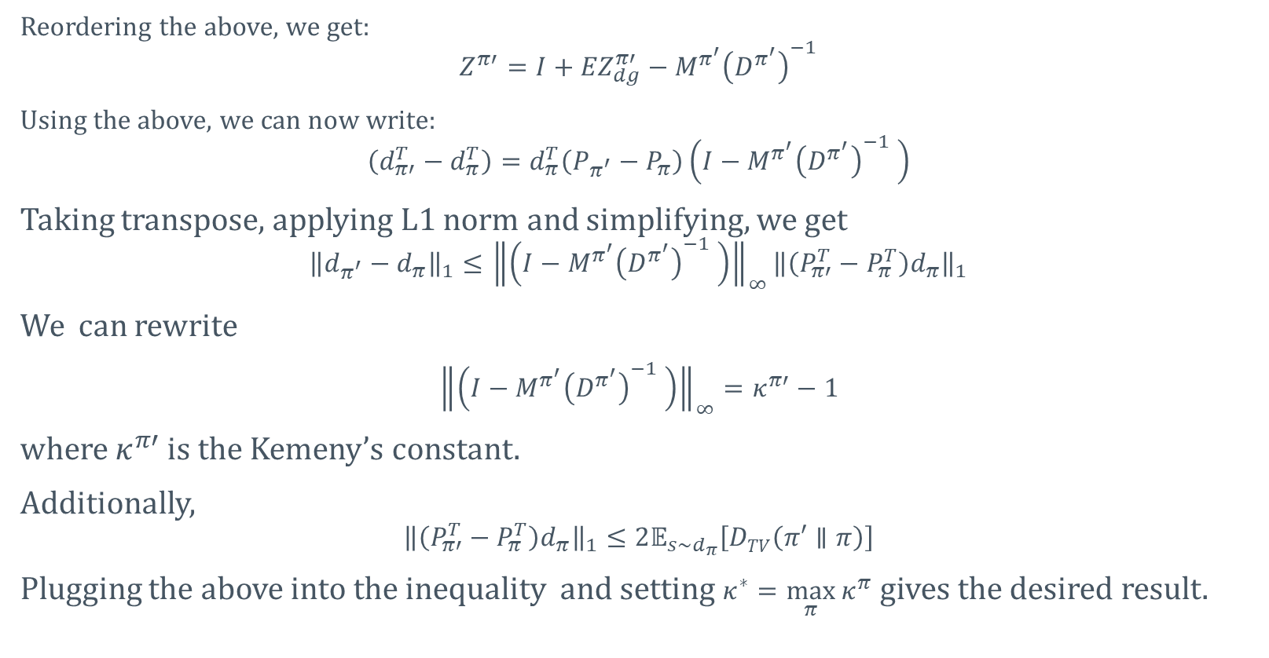
AVERAGE REWARD POLICY IMRPOVEMENT THEOREM
Reordering the above, we get:
$$Z^{π′}=I+{EZ}_{dg}^{π′}−M^{π^{′}}{\left(D^{π^{′}}\right)}^{−1}$$
Using the above, we can now write:
$$\left(d_{π′}^{T}−d_{π}^{T}\right)=d_{π}^{T}\left(P_{π^{′}}−P_{π}\right)\left(I−M^{π^{′}}{\left(D^{π^{′}}\right)}^{−1} \right)$$
Taking transpose, applying L1 norm and simplifying, we get
$${\left\|d_{π^{′}}−d_{π}\right\|}_{1}≤{\left\|\left(I−M^{π^{′}}{\left(D^{π^{′}}\right)}^{−1} \right)\right\|}_{∞}{\left\|\left(P_{π′}^{T}−P_{π}^{T}\right)d_{π}\right\|}_{1}$$
We can rewrite
${\left\|\left(I−M^{π^{′}}{\left(D^{π^{′}}\right)}^{−1} \right)\right\|}_{∞}=κ^{π′}−1$
where $κ^{π′}$ is the Kemeny’s constant.
Additionally,
$${\left\|\left(P_{π′}^{T}−P_{π}^{T}\right)d_{π}\right\|}_{1}≤2𝔼_{s\sim d_{π}}\left[DTV\left(π′∥π\right)\right]$$
Plugging the above into the inequality and setting $κ^{∗}=\max_{π}{κ^{π}}$ gives the desired result.

Slide 16
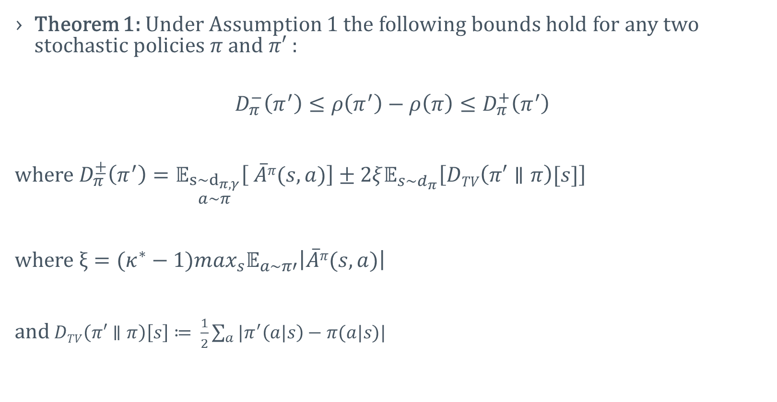
AVERAGE REWARD POLICY IMRPOVEMENT THEOREM
Theorem 1: Under Assumption 1 the following bounds hold for any two stochastic policies $π$ and $π′$ :
$$D_{π}^{−}\left(π^{′}\right)≤ρ\left(π^{′}\right)−ρ\left(π\right)≤D_{π}^{+}\left(π^{′}\right)$$
where $D_{π}^{±}\left(π^{′}\right)=𝔼_{\begin{matrix}s\sim d_{π,γ} \\ a\sim π\end{matrix}}\left[ \overline{A}π(s,a)\right]±2ξ𝔼_{s\sim d_{π}}\left[DTV\left(π′∥π\right)[s]\right]$
where $ξ=(κ^{∗}−1)\max_{s}𝔼_{a\sim π′}\left|\overline{A}π(s,a)\right|$
and $DTV\left(π′∥π\right)\left[s\right]≔ \frac{1}{2}\sum_{a}{|π^{′}\left(a|s\right)−π(a|s)|}$

Slide 17
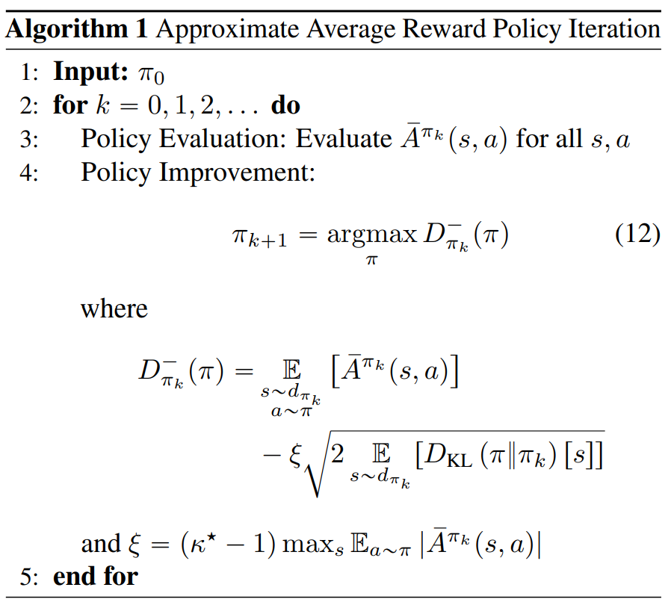
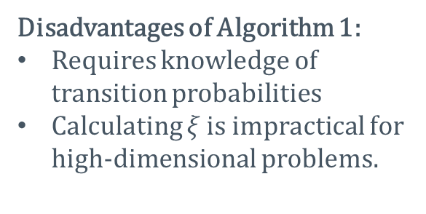
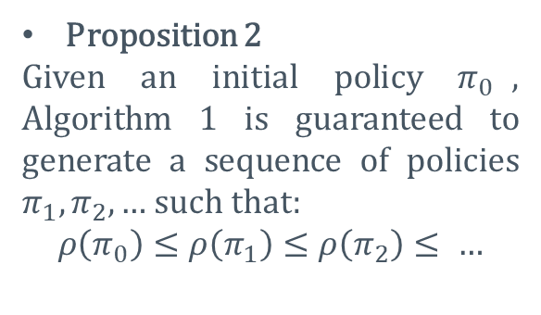
Approximate average reward policy iteration
Proposition 2
Given an initial policy $π_{0}$, Algorithm 1 is guaranteed to generate a sequence of policies $π_{1}, π_{2},…$ such that:
$$ρ\left(π_{0}\right)≤ρ\left(π_{1}\right)≤ρ\left(π_{2}\right)≤ …$$
Disadvantages of Algorithm 1:
Requires knowledge of transition probabilities
Calculating $ξ$ is impractical for high-dimensional problems.

Slide 18
PRACTICAL ALGORITHM

Slide 19
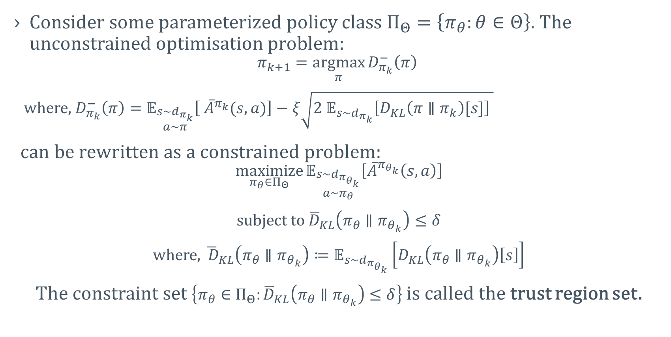
AVERAGE REWARD TRUST REGION METHODS
Consider some parameterized policy class $Π_{Θ}=\left\{π_{θ}:θ∈Θ\right\}$. The unconstrained optimisation problem:
$$π_{k+1}=\underset{π}{argmax}{D_{π_{k}}^{−}\left(π\right) }$$
where, $D_{π_{k}}^{−}\left(π\right)=𝔼_{\begin{matrix}s\sim d_{π_{k}} \\ a\sim π\end{matrix}}\left[ {\overline{A}}^{π_{k}}(s,a)\right]−ξ\sqrt{{2 𝔼}_{s\sim d_{π_{k}}}\left[D_{KL}\left(π∥π_{k}\right)[s]\right] }$
can be rewritten as a constrained problem:
$$\underset{π_{θ}{∈Π}_{Θ}}{maximize}{𝔼_{\begin{matrix}s\sim d_{π_{θ_{k}}} \\ a\sim π_{θ}\end{matrix}}\left[{\overline{A}}^{π_{θ_{k}}}\left(s,a\right)\right]}$$
subject to ${\overline{D}}_{KL}\left(π_{θ}∥π_{θ_{k}}\right)≤δ$
where, ${\overline{ D}}_{KL}\left(π_{θ}∥π_{θ_{k}}\right)≔𝔼_{s\sim d_{π_{θ_{k}}}}\left[D_{KL}\left(π_{θ}∥π_{θ_{k}}\right)\left[s\right]\right]$
The constraint set $\left\{π_{θ}∈Π_{Θ}:{\overline{D}}_{KL}\left(π_{θ}∥π_{θ_{k}}\right)≤δ\right\}$ is called the trust region set.

Slide 20
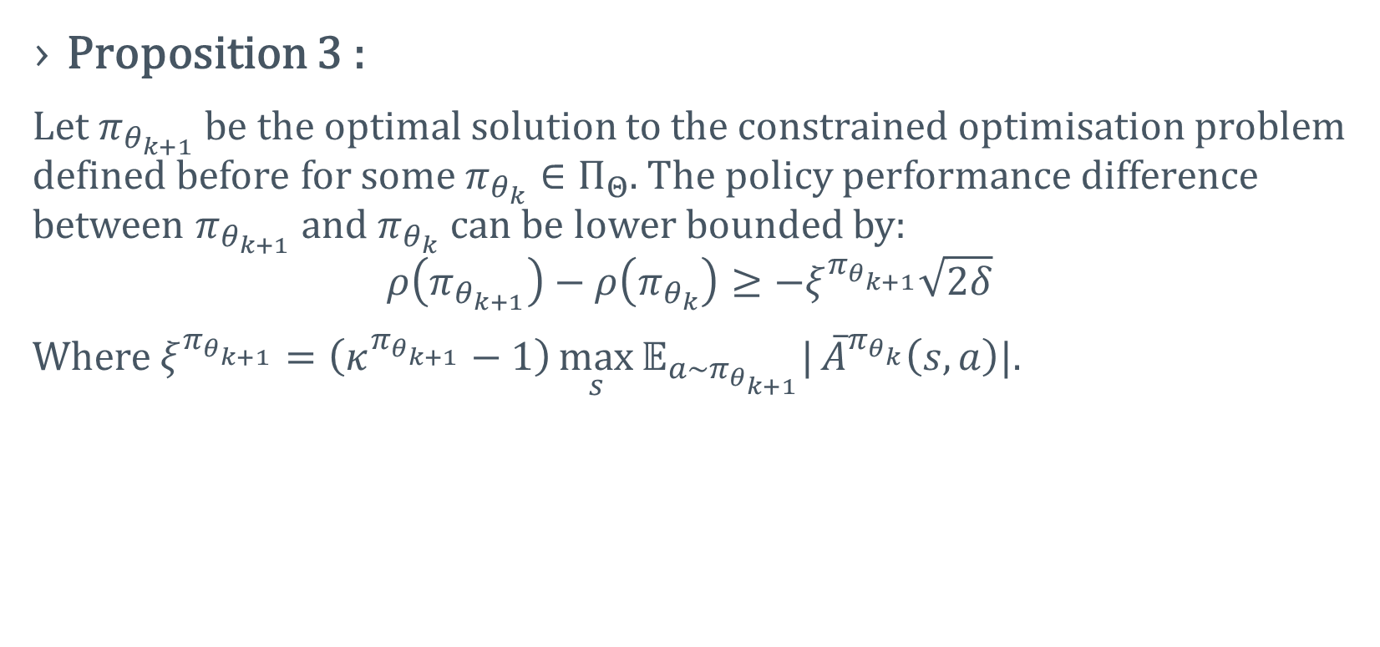
AVERAGE REWARD TRUST REGION METHODS
Proposition 3 :
Let${ π}_{θ_{k+1}}$be the optimal solution to the constrained optimisation problem defined before for some $π_{θ_{k}}∈Π_{Θ}$. The policy performance difference between $π_{θ_{k+1}}$and $π_{θ_{k}}$ can be lower bounded by:
$$ρ\left(π_{θ_{k+1}}\right)−ρ\left(π_{θ_{k}}\right)≥−ξ^{π_{θ_{k+1}}}\sqrt{2δ}$$
Where $ξ^{π_{θ_{k+1}}}=\left(κ^{π_{θ_{k+1}}}−1\right)\max_{s}{𝔼_{a\sim π_{θ_{k+1}}}|}{\overline{A}}^{π_{θ_{k}}}\left(s,a\right)|$.

Slide 21
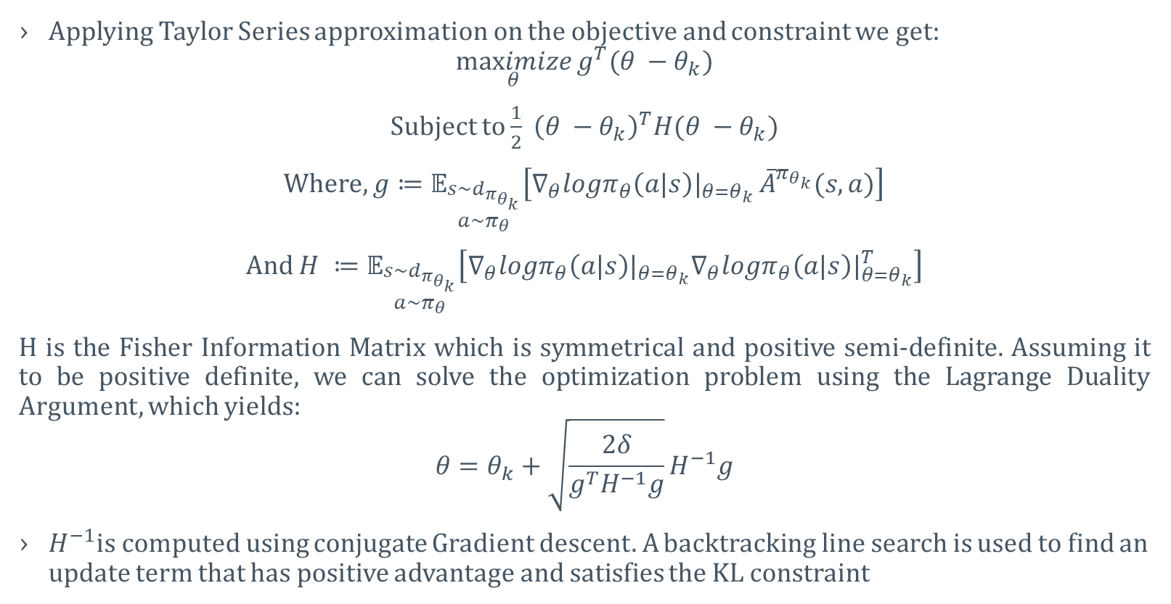
AVERAGE REWARD TRPO (ATRPO)
Applying Taylor Series approximation on the objective and constraint we get:
$$\underset{θ}{maximize}{g^{T}(θ −θ_{k})}$$
Subject to $\frac{1}{2} {\left(θ −θ_{k}\right)}^{T}H(θ −θ_{k})$
Where, $g≔𝔼_{\begin{matrix}s\sim d_{π_{θ_{k}}} \\ a\sim π_{θ}\end{matrix}}\left[∇_{θ}logπ_{θ}\left(a|s\right)|_{θ=θ_{k}} {\overline{A}}^{π_{θ_{k}}}(s,a)\right]$
And $H ≔𝔼_{\begin{matrix}s\sim d_{π_{θ_{k}}} \\ a\sim π_{θ}\end{matrix}}\left[∇_{θ}logπ_{θ}\left(a|s\right)|_{θ=θ_{k}}∇_{θ}logπ_{θ}\left(a|s\right)|_{θ=θ_{k}}^{T}\right]$
H is the Fisher Information Matrix which is symmetrical and positive semi-definite. Assuming it to be positive definite, we can solve the optimization problem using the Lagrange Duality Argument, which yields:
$$θ=θ_{k}+\sqrt{\frac{2δ}{g^{T}H^{−1}g}}H^{−1}g$$
$H^{−1}$is computed using conjugate Gradient descent. A backtracking line search is used to find an update term that has positive advantage and satisfies the KL constraint

Slide 22
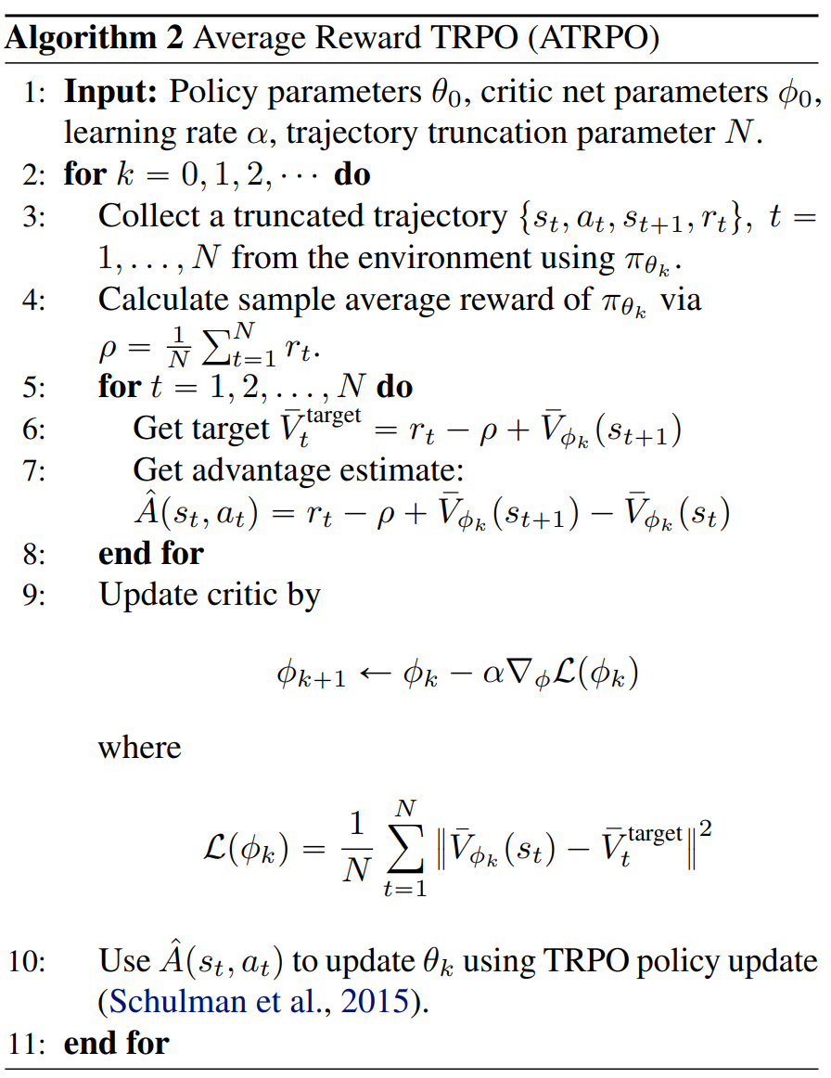
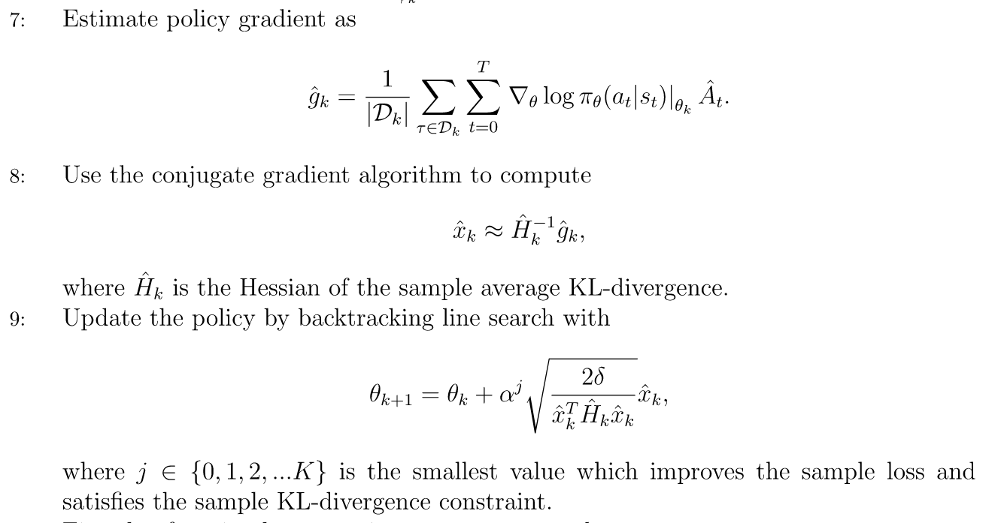
AVERAGE REWARD TRPO ALGORITHM (ATRPO)
TRPO policy update

Slide 23
RESULTS

Slide 24
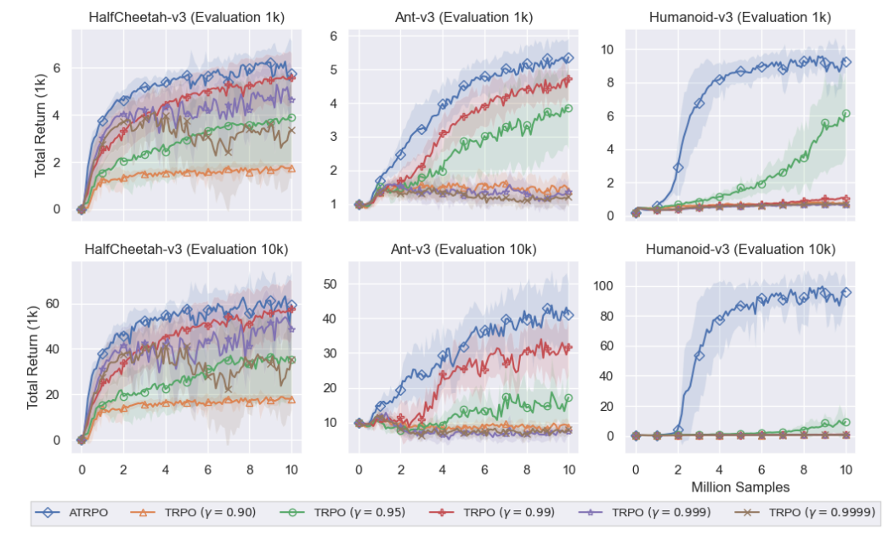
EVALUATION PROTOCOL:
A policy was trained for 10 million environment steps. Every 100,000 steps, 10 separate evaluation trajectories were run with the current policy without exploration. For each evaluation trajectory the undiscounted return of the trajectory until the agent falls or until 1,000 steps, whichever comes first, were calculated.

Slide 25
RESULTS – OUR WORK

Slide 26
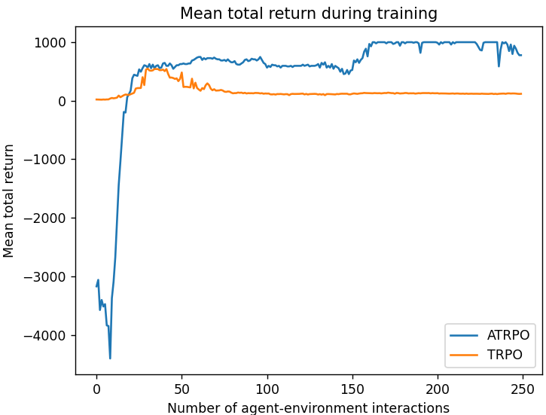
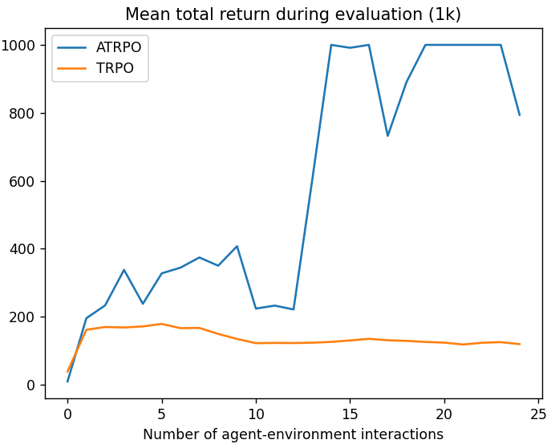
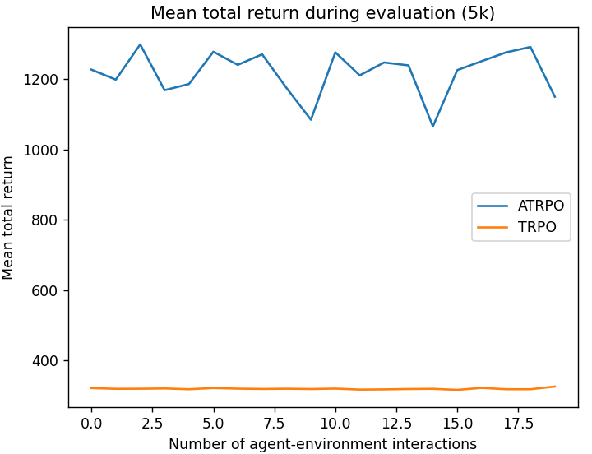
EVALUATION PROTOCOL:
Policy trained for 250 environment steps. Every 10 steps, 5 separate evaluation trajectories were run with the current policy without exploration. For each evaluation trajectory the undiscounted return of the trajectory until the agent falls or until 1,000 steps, whichever comes first, were calculated.

Slide 27
EXTENDING THE IDEA TO PPO

Slide 28
REFERENCES
Zhang, Y. and Ross, K.W., 2021, July. On-policy deep reinforcement learning for the average-reward criterion. In International Conference on Machine Learning (pp. 12535-12545). PMLR.
Blackwell, D. Discrete dynamic programming. The Annals of Mathematical Statistics, pp. 719–726, 1962.
Schulman, J., Levine, S., Abbeel, P., Jordan, M., and Moritz, P. Trust region policy optimization. In International Conference on Machine Learning, pp. 1889–1897, 2015.
Achiam, J., Held, D., Tamar, A., and Abbeel, P. Constrained policy optimization. In Proceedings of the 34th International Conference on Machine Learning-Volume 70, pp. 22–31. JMLR. org, 2017.
TRPO implementation - https://gist.github.com/elumixor/c16b7bdc38e90aa30c2825d53790d217

Slide 29
THANK YOU!

